Slide 1

Chapter 7 Transmission Media
7.1
Copyright © The McGraw-Hill Companies, Inc. Permission required for reproduction or display.

Slide 2
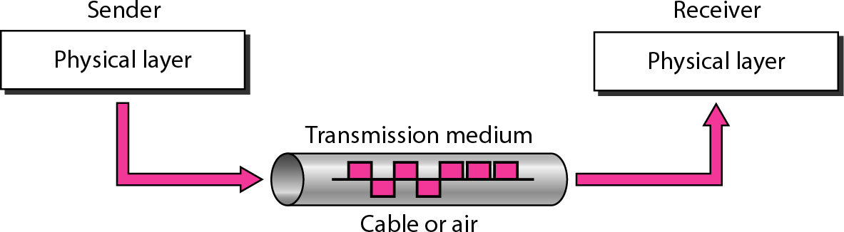
Figure 7.1
Transmission medium and physical layer
7.<number>

Slide 3

Figure 7.2
Classes of transmission media
7.<number>

Slide 4






























7-1 GUIDED MEDIA
Guided media, which are those that provide a conduit from one device to another, include twisted-pair cable, coaxial cable, and fiber-optic cable.
Topics discussed in this section:
Twisted-Pair Cable Coaxial Cable Fiber-Optic Cable
7.<number>

Slide 5

Figure 7.3
Twisted-pair cable
Twisted pair cable reduces the electromagnetic (flow in wire or wireless medium) interference
7.<number>

Slide 6

Figure 7.4
S-Shielded- protects the wire from any outside electromagnetic interference
UTP and STP cables S-Shielded
U-Unshielded
7.<number>

Slide 7
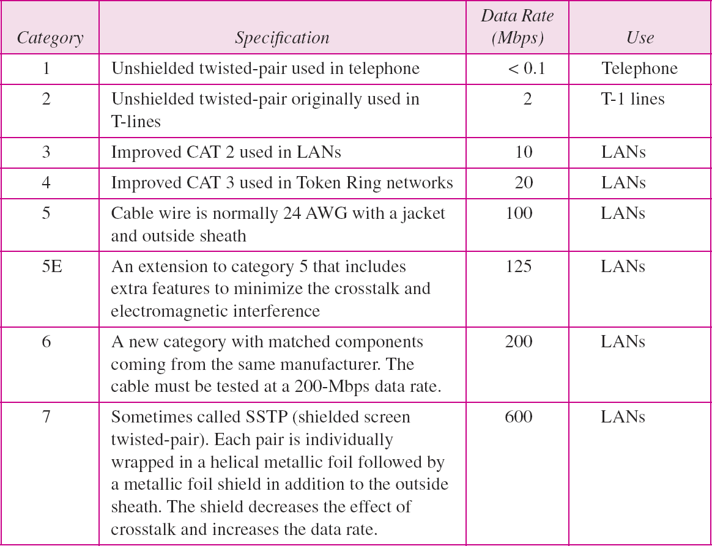
Table 7.1
Categories of unshielded twisted-pair cables
7.<number>

Slide 8

Figure 7.5
UTP connector
7.<number>

Slide 9
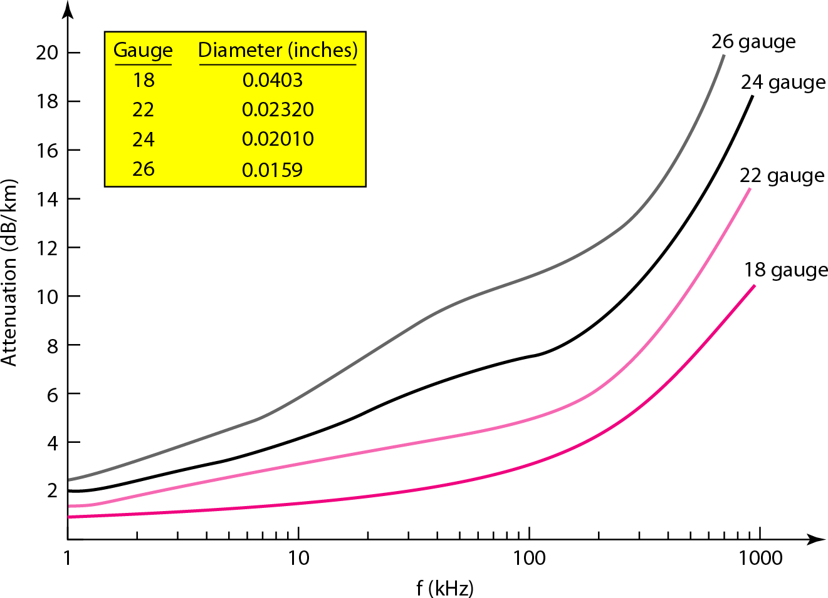
Figure 7.6
UTP performance
7.<number>

Slide 10

Figure 7.7
Coaxial cable
7.<number>

Slide 11

Table 7.2
Categories of coaxial cables
7.<number>

Slide 12

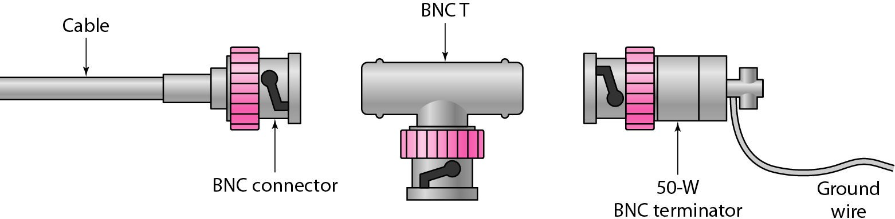
Figure 7.8
BNC connectors
Bayonet Neill–Concelman
7.<number>

Slide 13

Figure 7.9
Coaxial cable performance
7.<number>

Slide 14
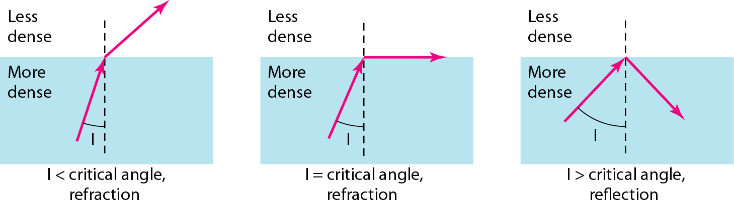
Figure 7.10
Bending of light ray Snell’s Law- Total Internal Reflection
7.<number>

Slide 15
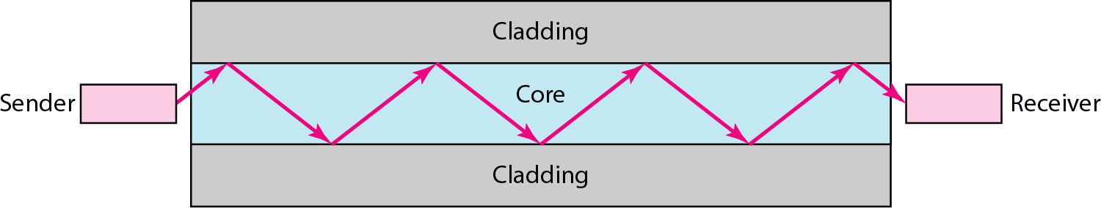
Figure 7.11 Optical fiber
Photo Diode
Optical to Electrical conversion takes place
LED or LASER
Electrical to Optical conversion takes place
7.<number>

Slide 16

Figure 7.12
Propagation modes
Mode is a set of electric and magnetic field which satisfy the boundary condition and thus propagation in optical fiber is in accordance with the Maxwell equations
7.<number>

Slide 17
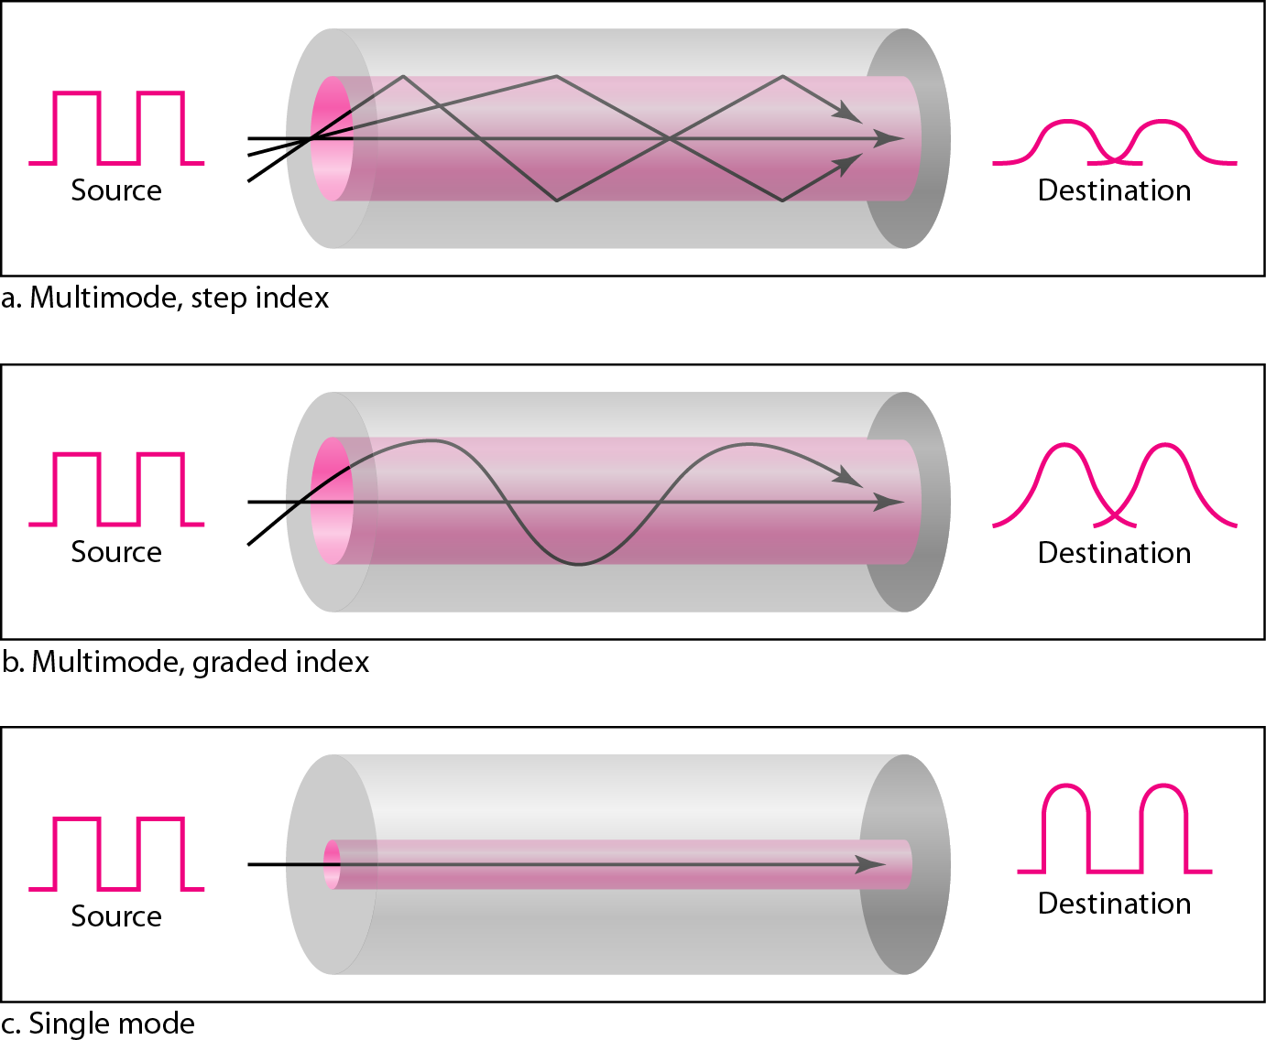
Figure 7.13
Modes
7.<number>

Slide 18

Table 7.3 Fiber types
7.<number>

Slide 19

Figure 7.14
Fiber construction
7.<number>

Slide 20
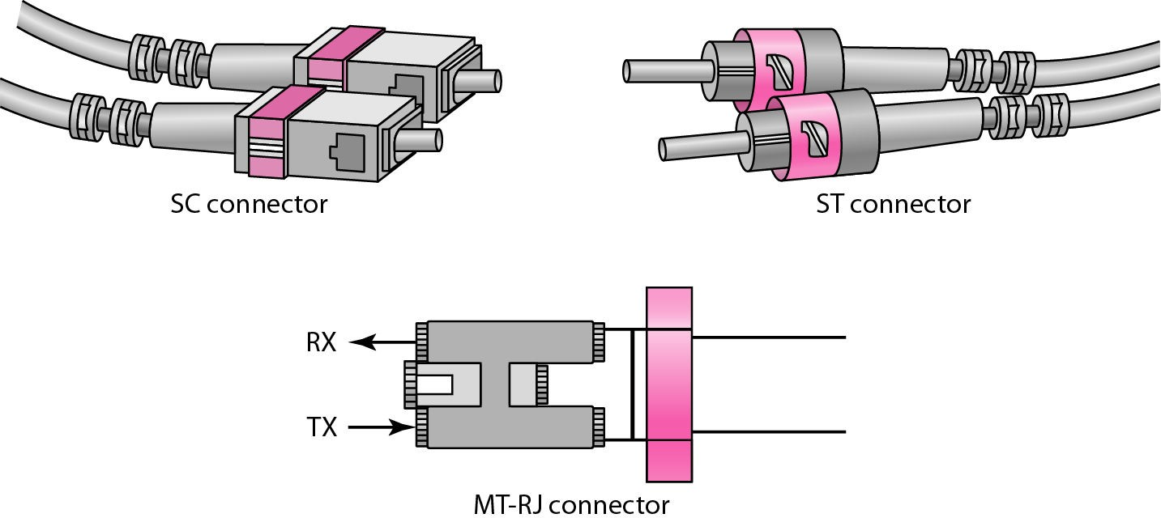
Figure 7.15
Fiber-optic cable connectors
7.<number>

Slide 21

Figure 7.16
Optical fiber performance
7.<number>

Slide 22






















7-2 UNGUIDED MEDIA: WIRELESS
Unguided media transport electromagnetic
waves This type of
as
without using a communication communication.
physical conductor. is often referred to
wireless
Topics discussed in this section:
Radio Waves Microwaves Infrared
7.<number>

Slide 23
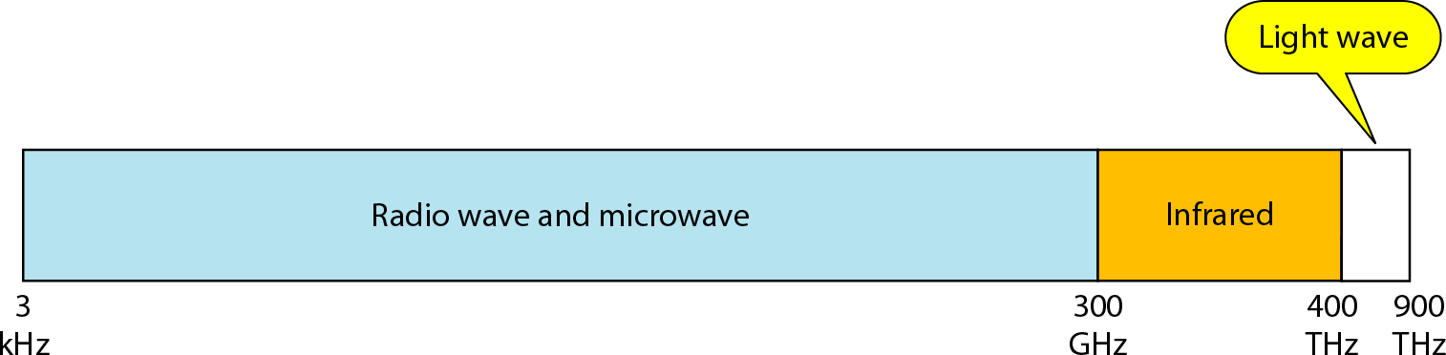
Figure 7.17
Electromagnetic spectrum for wireless communication
7.<number>

Slide 24
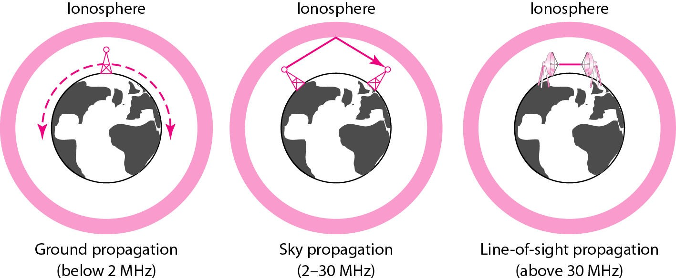
Figure 7.18
Propagation methods
7.<number>

Slide 25
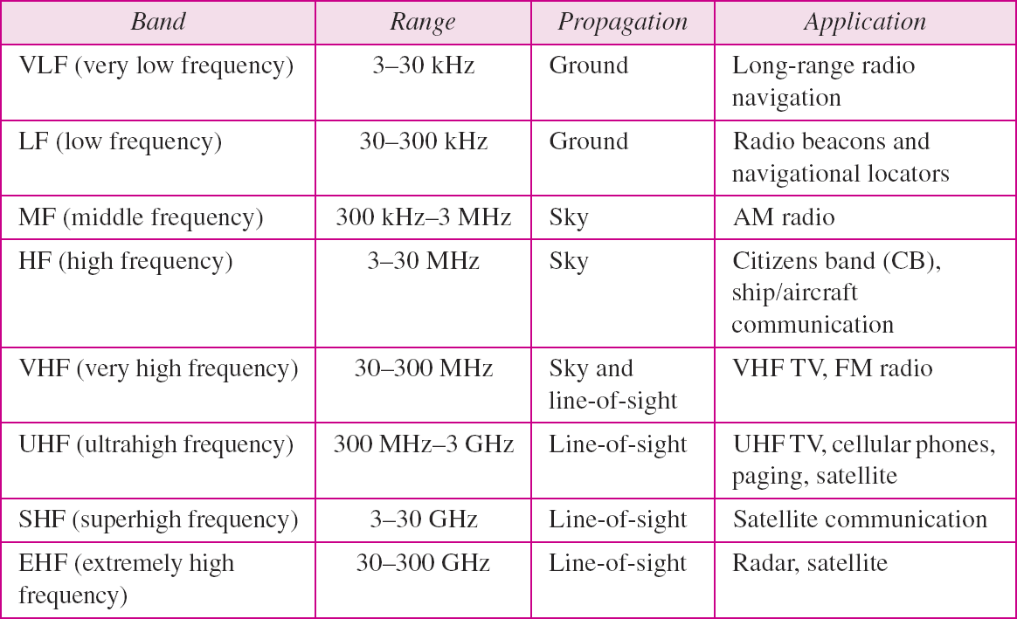
Table 7.4
Bands
7.<number>

Slide 26

Figure 7.19
Wireless transmission waves
7.<number>

Slide 27

Figure 7.20
Omnidirectional antenna
7.<number>

Slide 28


Note
Radio waves are used for multicast communications, such as radio and television, and paging systems.
7.<number>

Slide 29
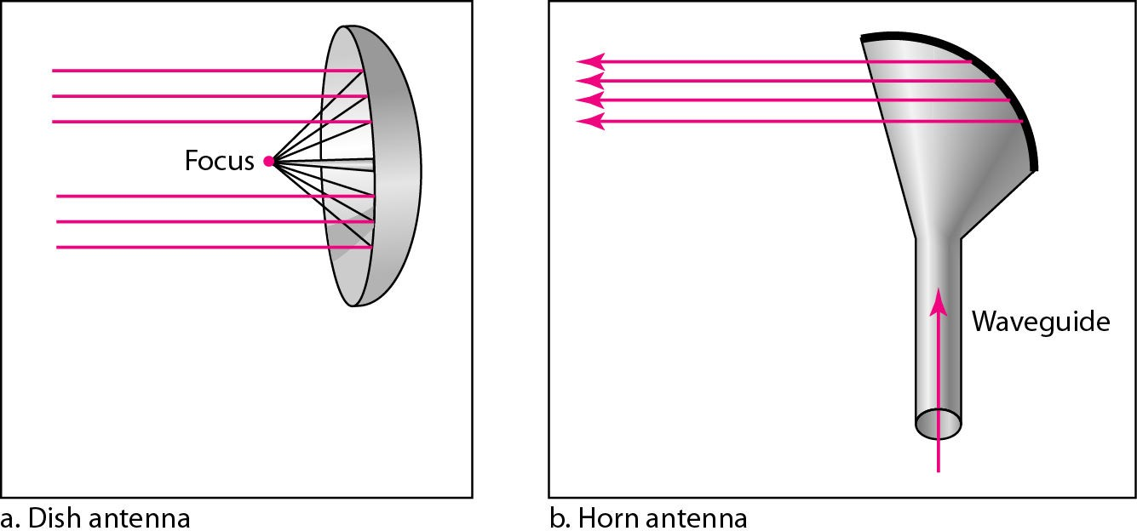
Figure 7.21
Unidirectional antennas
7.<number>

Slide 30

Note
Microwaves are used for unicast communication such as cellular telephones, satellite networks, and wireless LANs.
7.<number>

Slide 31

Note
Infrared signals can be used for short- range communication in a closed area using line-of-sight propagation.
7.<number>

